Slide 1
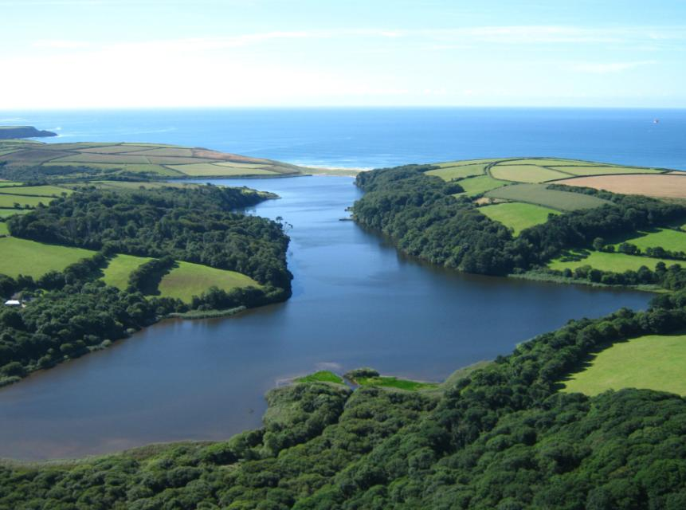
Loe Pool and River Cober catchment
Lewis Jones, South West Water
Jan Dinsdale, Loe Pool Forum

Slide 2
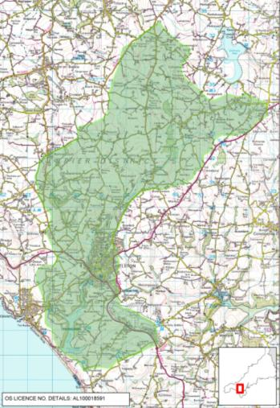





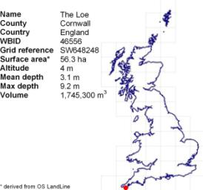


Loe Pool Catchment Management Forum
Notes:
Location, catchment and Loe Pool Forum
Loe Pool and River Cober catchment situated in west Cornwall, at the top of the Lizard Peninsula.
The catchment area is ca 60km2, with Loe Pool at bottom of catchment between the town of Helston and the sea.
The Loe Pool Forum is a group of organisations and individuals with an interest in the management of the Lake and its catchment. The Forum formed in 1996, wrote its first ‘catchment management plan’ in 1997 and the group has continued to work together to manage and improve the condition of the lake and its catchment since that date.
The main organisations working collaboratively through the Loe Pool Forum are shown here. The Forum is also building strong links within the local community, with farmers, anglers, walkers and indeed everyone who plays a role in the lake’s management or has an interest in its future.

Slide 3
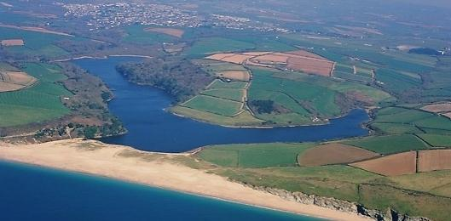
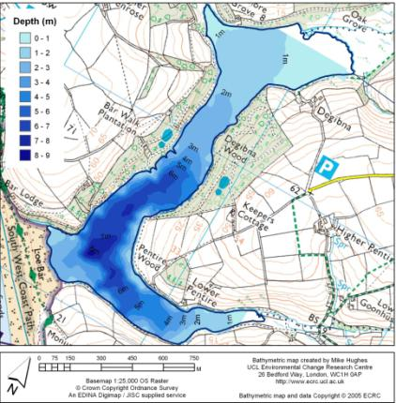
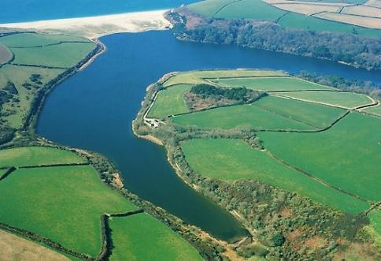
Loe Pool
Notes:
Background to the Loe catchment system
Loe = Pool in Cornish
The Loe has a surface area of about 56 ha, making it the largest freshwater lake in Cornwall.
It is reputed to be the final resting place of King Arthur’s sword, Excalibur.
The Pool forms part of the Penrose Estate, owned and managed by the National Trust.
The lake and the sea are only a few metres apart and separated by a natural shingle beach barrier or bar, seen here.
Bathymetric survey data from 2000 shows lake ca. 9m deep at the deepest point, which is just off the bar, where the two ‘arms’ of the lake meet. The central neck of the lake is also quite deep, 4-6m but about half of the lake is less than 3m in depth.
Water coming in: The River Cober is the main source of water into the Loe, delivering more than 80% of flow, flowing in from the north, through the town of Helston (top aerial LHS). A small stream flows into Carminowe Creek (the eastern arm of the Lake) and there are 3 other minor tributaries.
Water flowing out?: There is quite a fascinating history of how water drains from the Loe ....

Slide 4
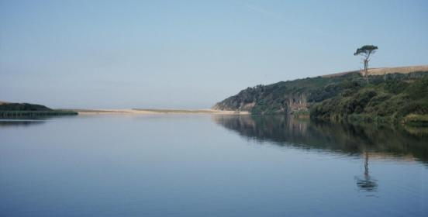
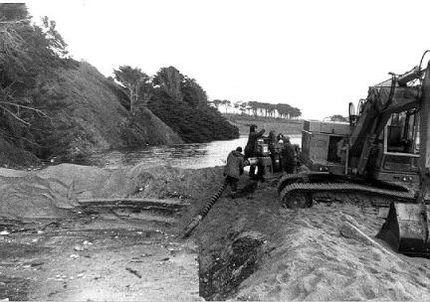
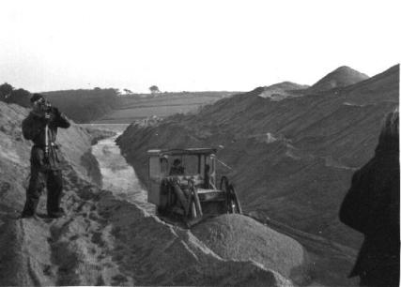
Breaking the bar ...
Photos: Dave Davies
Notes:
Legend has it that Loe Bar was formed when a pair of ancient giants fell out and one dropped his bag of sand across the mouth of the River Cober while running away from another giant who was throwing rocks at him. While most people seem to have discounted that explanation, there is still some local controversy around how the Bar was formed. Perhaps the most plausible theory is that the Bar formed as a result of the Post Glacial rise in sea level.
Within recorded history, the Bar was a much smaller and less permanent feature than it is today. The bar continues to build as shingle is deposited during storm events.
It is thought that pre deep mining activity in 18-19C water percolated through the sand out to sea.
During 19th century, old maps and written records suggest that the bar was around half the width it is now and much lower. At that time the natural processes of the Bar were disturbed by regular ‘breaking of the bar’
to let floodwater out during the winter months.
This action was taken to prevent flooding in the many mines in the Cober valley.
But the risk of flooding had also been increased by the very large quantities of fine mineral waste being discharged from the mines into the River Cober. This fine silt blocked the pore spaces in the shingle Bar which greatly reduced the infiltration capacity of the shingle, increasing the frequency and size of flood events.
The bar was broken 3 times in the 20th C. These photos were taken in 1979. It was always a risky business working with the force of flood waters and the tide. The bar was last broken by SWW in 1984 and on this occasion most of the lake drained out to sea, cutting a channel 60m wide and 10m deep. The scar through the bar is still evident today. So after that, a more permanent concrete outlet tunnel was constructed along the western edge of the bar. Lake levels now are much more stable – which is better for flooding, but less beneficial for wildlife ….

Slide 5
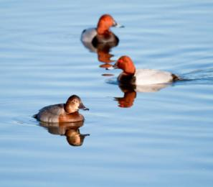
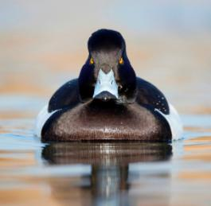
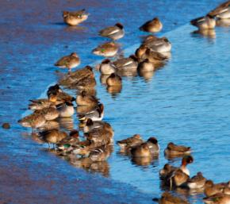
SSSI: Wintering wildfowl
Photos: David Chapman
Notes:
Loe Pool is designated a Site of Special Scientific Interest for its rare plant and wildlife species. It is an important haven for overwintering wildfowl, such as the pochard, tufted duck and teal seen here. Internationally important numbers of pochard seen on the Pool in winter, as well as many rarities and migrants. Bird numbers seem to be little affected by the change in the condition of the lake through the 20th C.

Slide 6
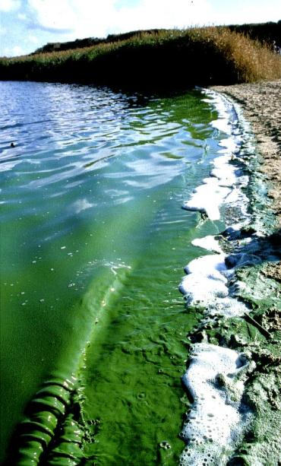
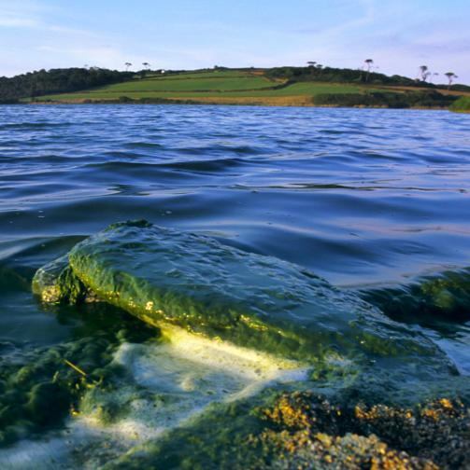
Failing SSSI and WFD
Photo: David Chapman
Notes:
Loe Pool would at one time have had very clear water with native trout and abundant underwater plants.
In 1848 the CA Johns wrote ‘ In summer, the whole of the lake, except some of the very deepest parts, is filled to the surface with a tangled weeds, which greatly interfere with the sport of the fisherman; these are perfoliate and small pondweed.’
As with many UK Lowland Lakes, Loe Pool is currently eutrophic.
It has a high nutrient status. Eutrophication is defined as the ecological change brought about by elevated levels of nutrients in the lakes water.
These images of blue-green algal blooms were taken in the late 1990s. Algal blooms began in the 1960s and occurred most summers until 2006.
The problem was made worse by the presence of a non-native macro-alga called ‘waternet’,. It bloomed in midsummer for about 20 years in Loe Pool from mid 1980s, smothering other organisms both in the water and on the shoreline too.
So as a eutrophic lake, with regular algal blooms and a declining trout population Loe Pool is classified as Poor Ecological Status under WFD and the condition of the SSSI waterbody is currently ‘unfavourable’.
What are the Loe Pool Forum doing about it?

Slide 7
Historic, current and target total phosphorus concentrations for Loe Pool
Notes:
We’ve made some amazing progress already!
This graph is taken from 2009 Loe Pool Catchment Management Plan written by Jan Dinsdale.
In 1996 when the Forum first formed the EA recorded P levels at the Lake outfall, and researchers predicted P levels from export co-efficients around the 300-350 ug/l level (green bars on graph).
Following the installation of Tertiary treatment plant at SWW’s Helston STW in 2003 (UWWTD) TP levels in the Loe fell dramatically from 300ug/l to 70-80ug/l. They have been stable at this level for about 7 years now.
This represents a four-fold reduction in Total Phosphorus – and such a dramatic response in-lake nutrient status to changes in external nutrient loads is fairly unusual in Lowland Eutrophic Lakes. Generally, when external sources of P are removed, there is an internal load of P from lake sediments which kicks in and continues to maintain high P levels.
The Loe Pool Management Forum hypothesize that it is the Loe’s long history of metal mining which is playing a positive role here. The high iron and copper levels in the sediment help to lock-up phosphorus in the sediment, preventing its re-release into the water. An MSc project by Justin Olosunde in 2002 supports this hypothesis, he found very high metal levels in the sediment right across the lake. It is hoped that ongoing research work by Richard Jones of University of Exeter will reveal more about the sediments beneath the Pool and the role these play in the rehabilitation of the Lake.
This dramatic fall in P levels was closely followed with a decline and then cessation of the algal blooms – both Blue Green and the macro algae hydrodicyton. We have not had an algal bloom since 2006 in the Loe.
What are we aiming towards?
The WFD, SSSI and the Forum’s own target P levels for Loe Pool are very similar (purple-blue bars on graph) sitting around 20-25ug/l.
This agreed target P level would certainly help to ensure clear water, macrophyte dominated, stable ecological state. So delivering the Lake away from the eutrophic, algal blooms. But is this really realistically achievable? And what actions will the partner organisations and local community, who work together as the Loe Pool Forum, need to take to best work towards this target level? The move from 80ug/l to 20ug/l is another 4-fold reduction.

Slide 8
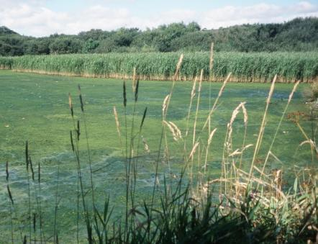
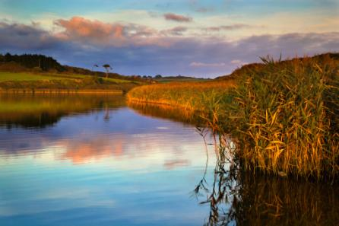
The future: clear water
Algal blooms a thing of the past
Recovery of macrophyte beds
Stable ecology
Photo: Jan Dinsdale
Photo: Jan Dinsdale
Photo: David Chapman
Notes:
The wide range of national and local organisations and individuals who have been working in partnership for over 15 years, continue as the Loe Pool Forum, to guide and facilitate the rehabilitation of Loe Pool.
Aim to get away from the algal soup seen in the top image [this is the non-native macoalgae Water Net (Hydrodicyton reticulatum)] towards a stable clear water state.
What is the Forum doing this year?
With so many different parties and individuals with an interest, the Forum currently comprises 4 smaller working groups:
A community group helping local people to become more involved
A group focussed on the point sources of nutrients – namely the two STW in the catchment
One group working with farmers across the catchment to address agricultural sources
One group focussing on the management of lake itself and lower stretch of the River Cober – looking at water level management, flood risk and conservation management of the lake
The next key step for the Forum is to develop a nutrient model for the catchment, using the data collected by EA WFD, SWW raw data from their drinking water abstraction from the River Cober, and Kelda Water Services Data collected from all of the Loe tributraies. Kelda manage the SWW for RNAS Culdrose.
The Forum will be working towards further reduction of nutrient inputs from both SWW and Kelda STW over next few years.
The way farmers manage their land in the catchment is also vital. We want to help ensure that farmers make the best use of their valuable nutrients for crop growth. Reducing loss of nutrients from the land and farmyard are a key part of us working together to improve the wildlife value of the Pool.
Well managed wetland habitats can also play an important role for water storage and also buffering more intensively management farmland.

Slide 9
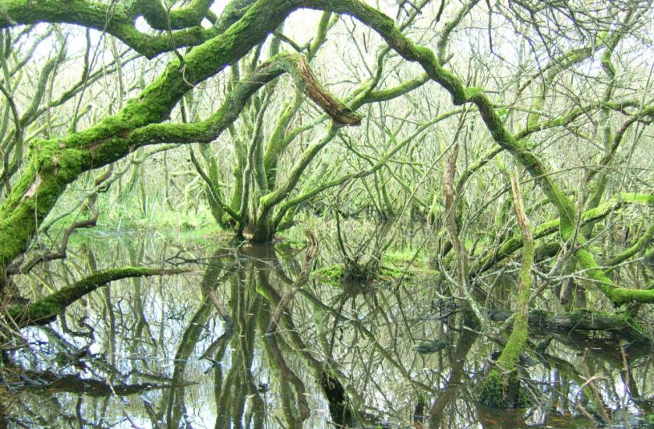
The Catchment Approach
Photo: Jan Dinsdale
Notes:
Drinking water, the River, the Lake and the whole local community all benefit from this work.
There are multiple benefits in this catchment approach for the members of the Loe Forum:
SWW also keen to work with the catchment group and land advisors to improve raw water quality. Drinking water abstracted mid-Cober
EA flood managers similarly keen to maximise water storage capacity and help slow water pathways to reduce flood risk in the lower catchment. Helston history of flooding.
NT as owners and managers of Loe Pool
Local community to increase appreciation of and pride in their local waterbody
NE with responsibility to improve the SSSI condition
EA again to deliver WFD
The nutrient modelling will help to highlight the importance of other potential sources of pollution, e.g. domestic septic tanks. This modelling will help to better target action on the ground across the catchment and throughout the local community.

Slide 10
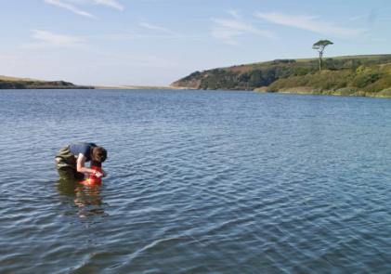
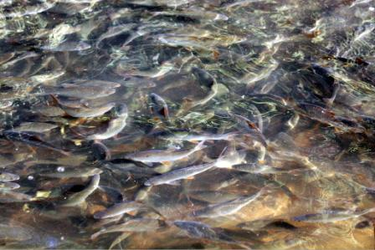
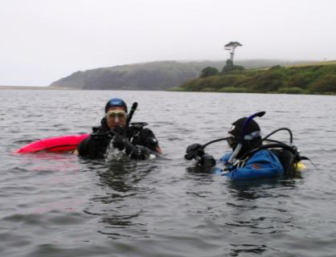
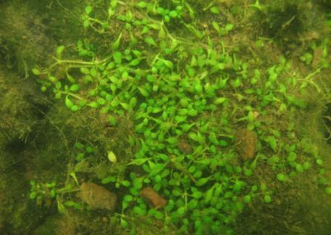
Photo: Jan Dinsdale
Photo: West Briton
Photo: Jan Dinsdale
Photo: Kennack Diving
Notes:
Alongside addressing nutrient inputs from the catchment, the Forum oversee survey work within the Pool help to build a picture of how the waterbody is responding.
Regular surveys of the underwater plant communities have been undertaken for almost 20 years by Forum’s ecologist, Jan Dinsdale. As yet the plant communities have been slow to respond to changes in P levels and the decline of algal blooms. Of course we are really keen to see recovery of macrophyte beds, and recognise this as a key step in whole lake rehabilitation.
Natural England funded a freshwater dive survey this summer to take a closer look at the plant communities.
There is an inundation plant community comprising needle spike rush, shoreweed and six-stamened waterweed (shown in photo); all tiny species confined to the shallow shelving shores. But there are no rooted plants in the deeper sections of the lake – and the sediment here is very unstable and mobile – which led to some exciting (dangerously sticky!) diving experiences this summer!
The National Trust really keen to carry out a fish survey, but this is not currently part of the WFD lake monitoring suite. We believe their are still resident trout, which turn silvery in the lake, as sea trout would, but are land-locked. But very few of these are caught by anglers, while the coarse fish community (rudd, roach and perch) appears to be thriving!

Slide 11
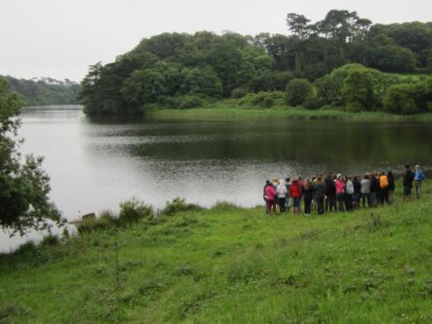
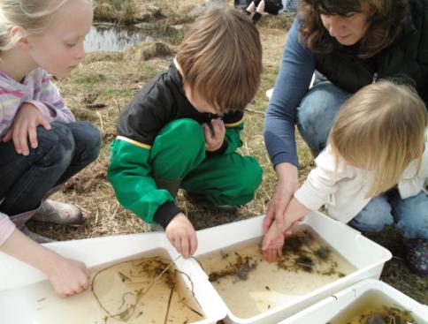
Local community
Photo: Tim Walker
Environmental education
Photo: Jan Dinsdale
Notes:
The National Trust own and manage Loe Pool and the surrounding Penrose Estate. There is a network of paths, wheelchair and cycle routes around the Pool, through semi-natural woodland, historic parkland and across the shingle bar. The Penrose Estate is open year round and the team of National Trust rangers are working hard to open new routes, work with local groups and schools and organise events and activities from pond-dipping to a green gym.

Slide 12
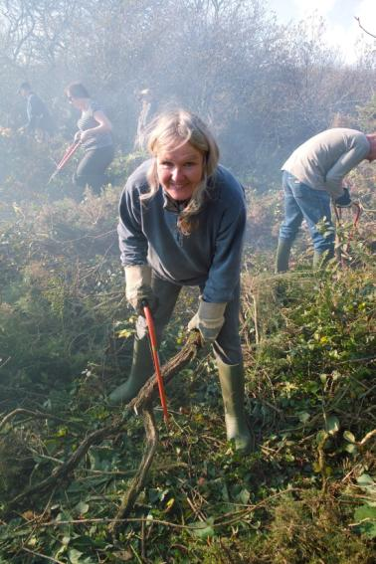
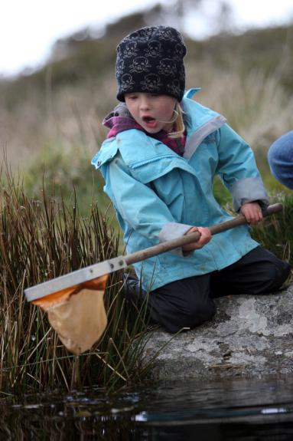
Enjoying nature and helping out
Photos: Jan Dinsdale
Notes:
Having local people involved and helping out with our work at Loe Pool is key to the project’s success.
The NT rangers lead on the community side of the Forum’s work, and provide a fantastic programme of activities and events to engage people of all ages and interests in Loe Pool. At these events, the rangers work to communicate the story of water travelling through the Loe catchment, our reliance on water in our homes and the connection of this to the health of Loe Pool to everyone.

Slide 13
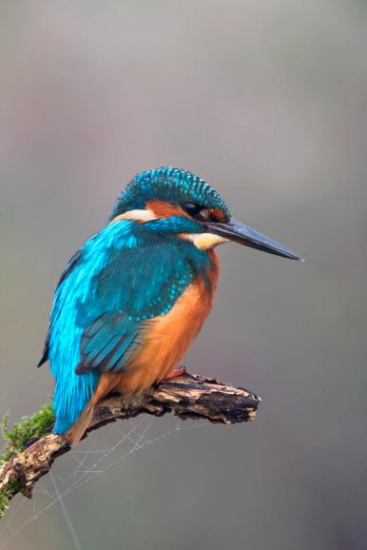





Thank you

Slide 14
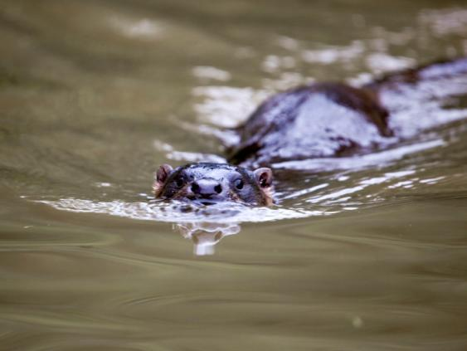
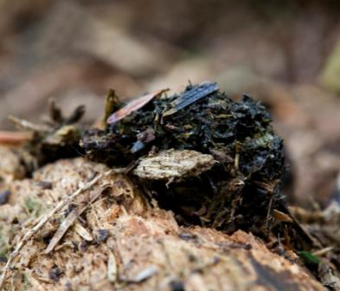
Improved water quality - Otter
Photos: David Chapman
Notes:
This is just for you Lewis!? Of course, leave it out if you don’t have time ....
Signs of otter are regularly spotted both around Loe Pool, and within wetland habitats across the Cober catchment. The mostly frequently observed sign of Otter is it’s calling card – its spraint, full of fish scales and frog bones and smelling sweetly fragrant (unlike mink scat which is truely stinky!). It is quite unusual to see the animal itself in Cornwall, however, there has been a number of sightings on the Pool in recent years. No doubt they are feasting on all the coarse fish!?

