Slide 1
Loe Bar – A Chronological Photo History!
David Davies
Dec 2012

Slide 2
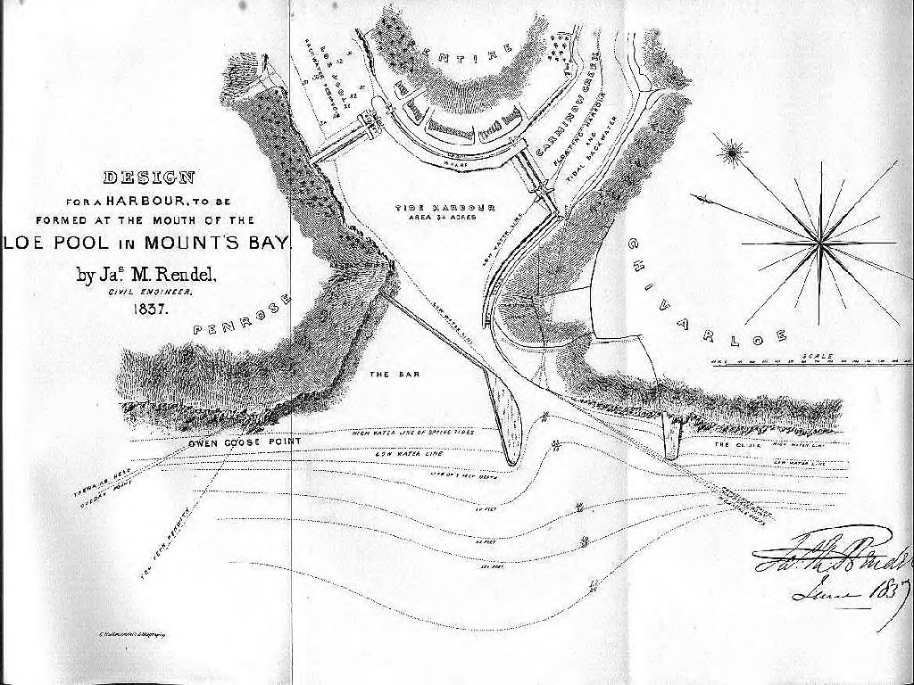
Helston Harbour Plan 1837

Slide 3
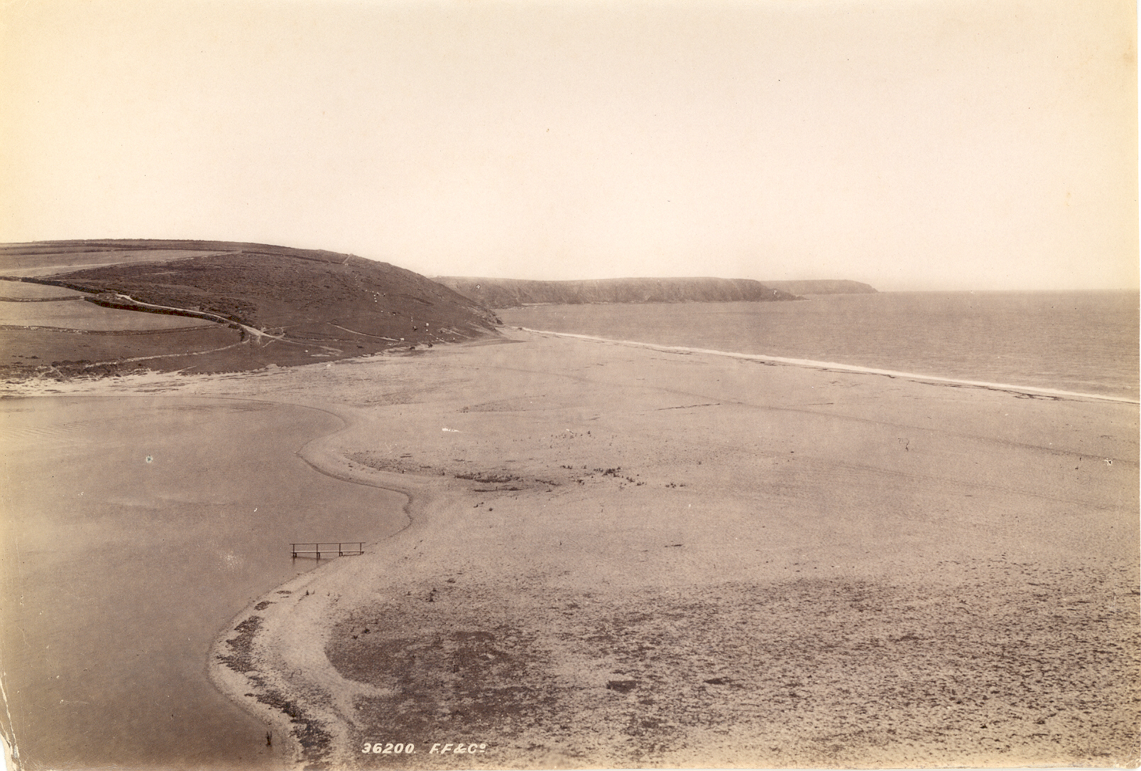
1895

Slide 4
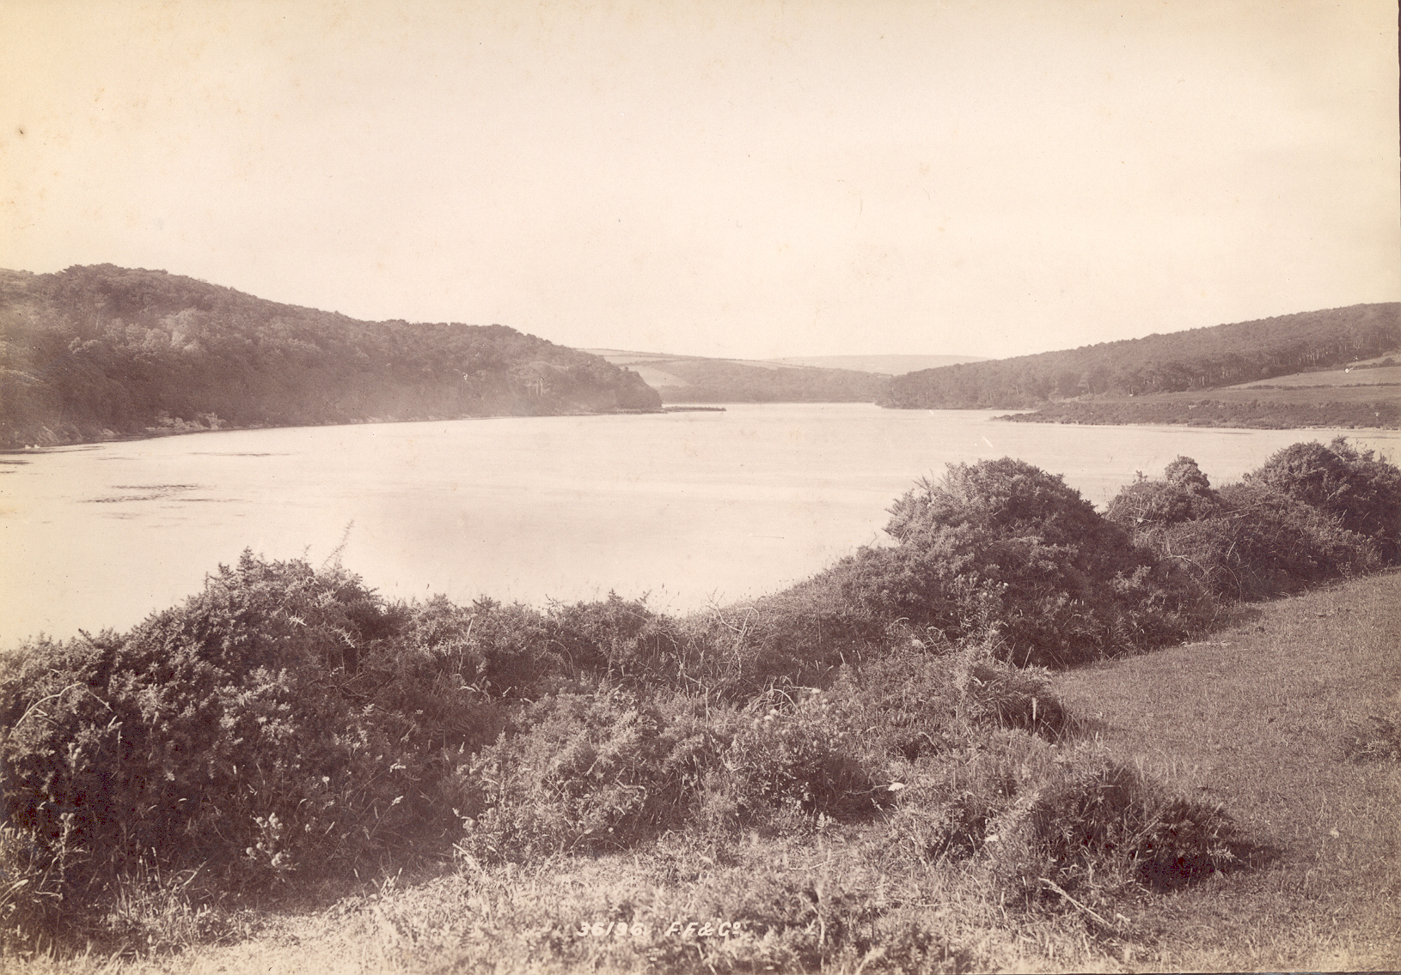
1895

Slide 5
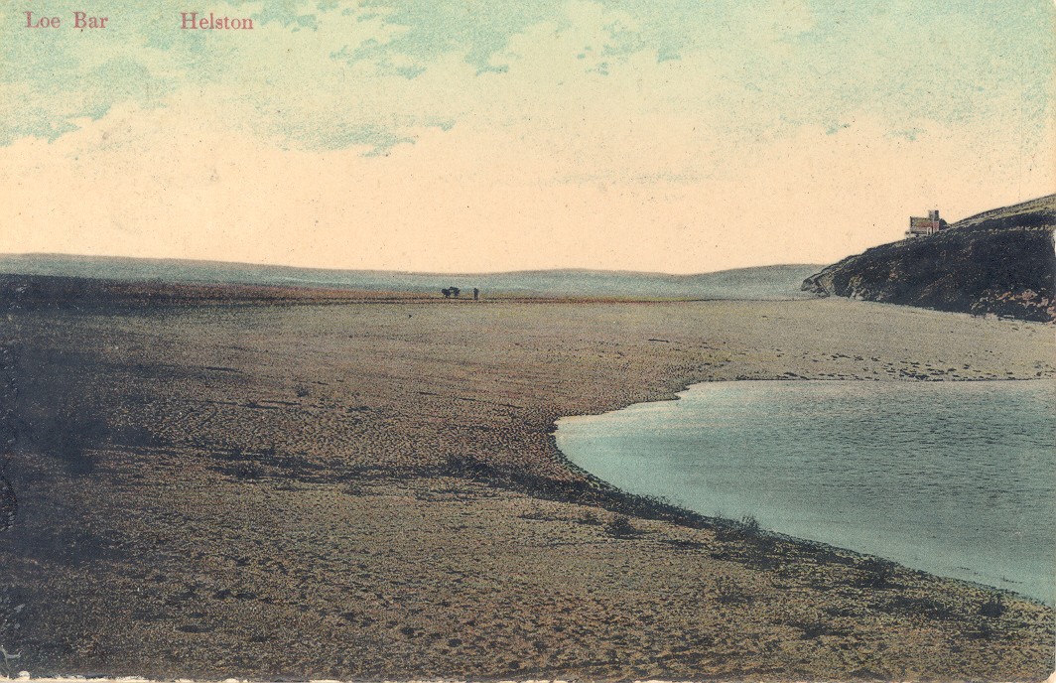
1914

Slide 6
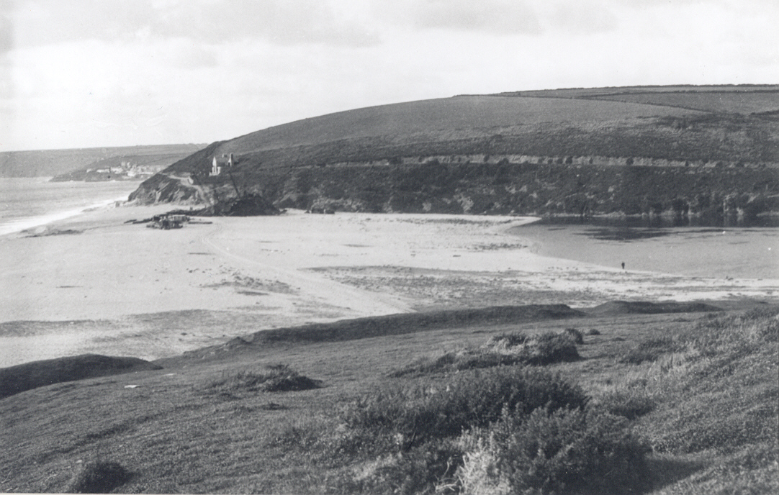
1914

Slide 7
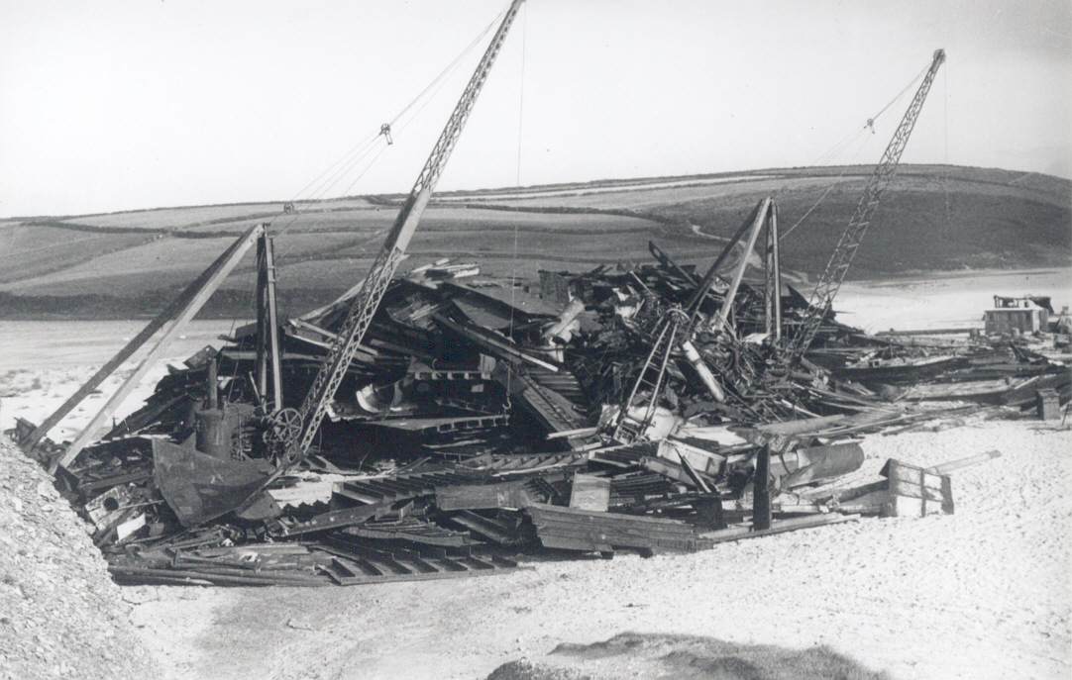
1914

Slide 8
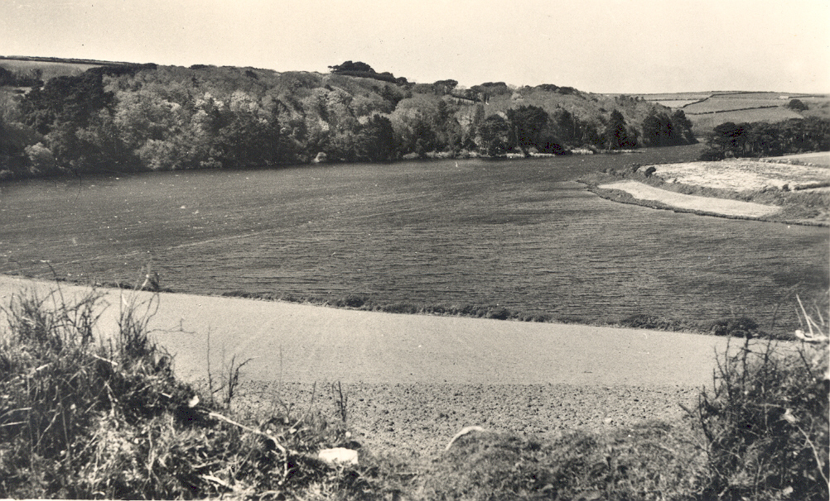
1915

Slide 9
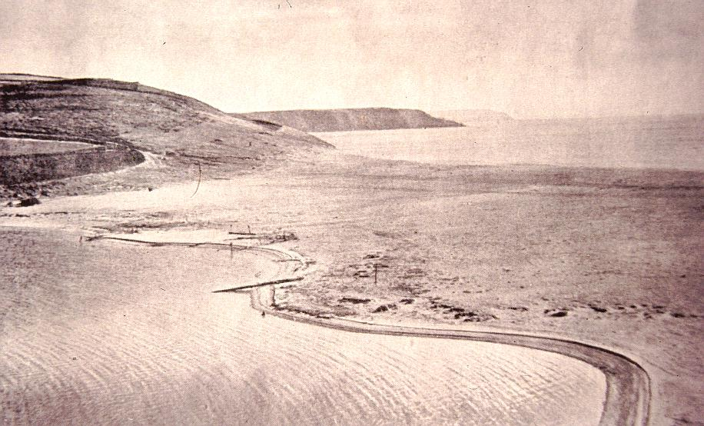
Late 1950’s

Slide 10
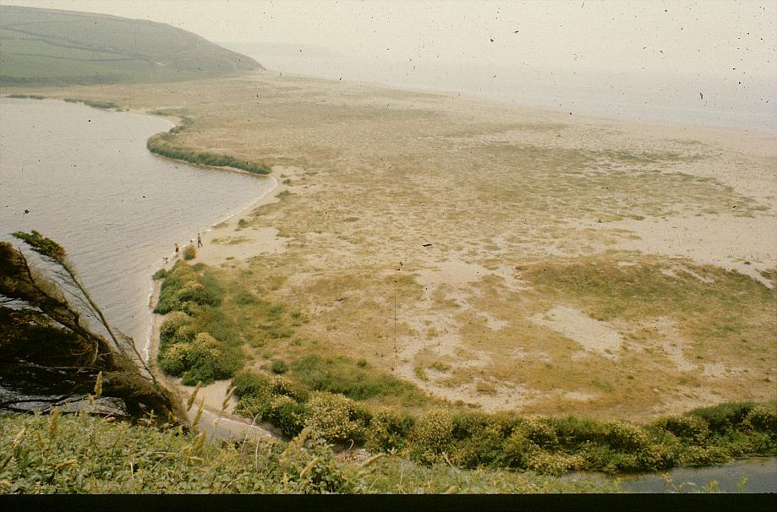
July 1977

Slide 11
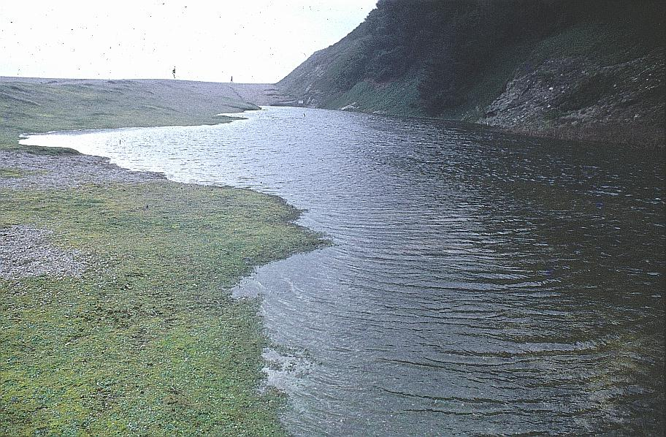
March 1978

Slide 12
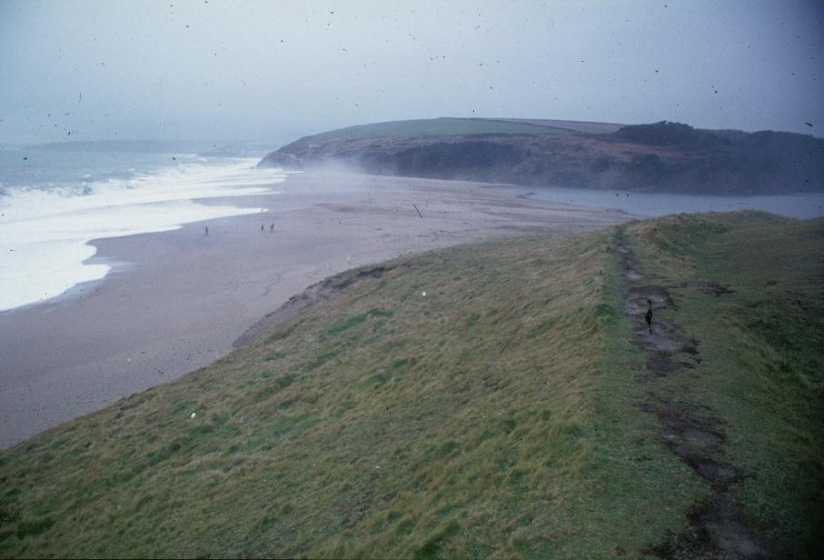
March 1978

Slide 13
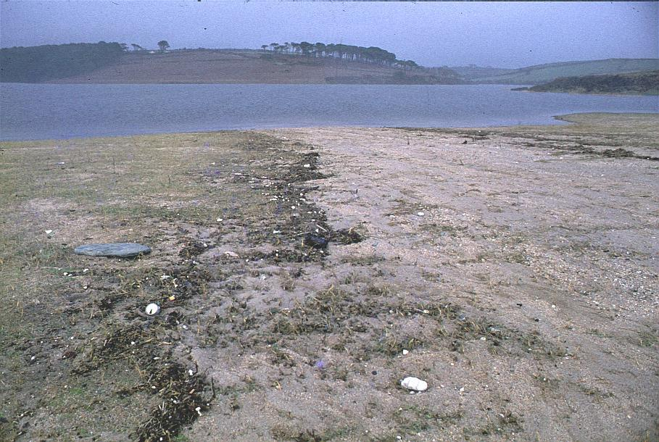
March 1978

Slide 14
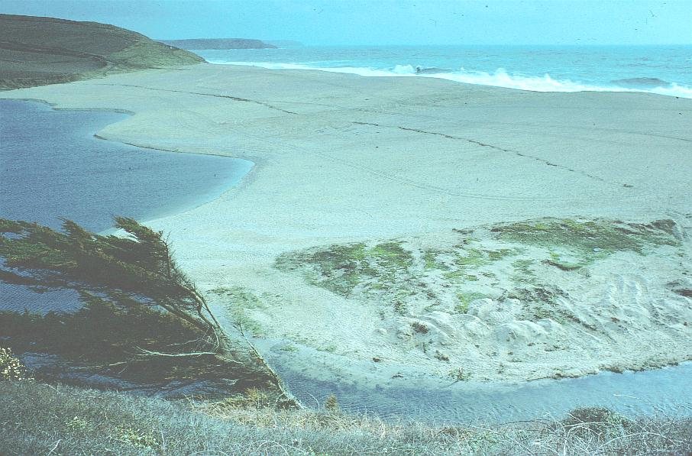
1979

Slide 15
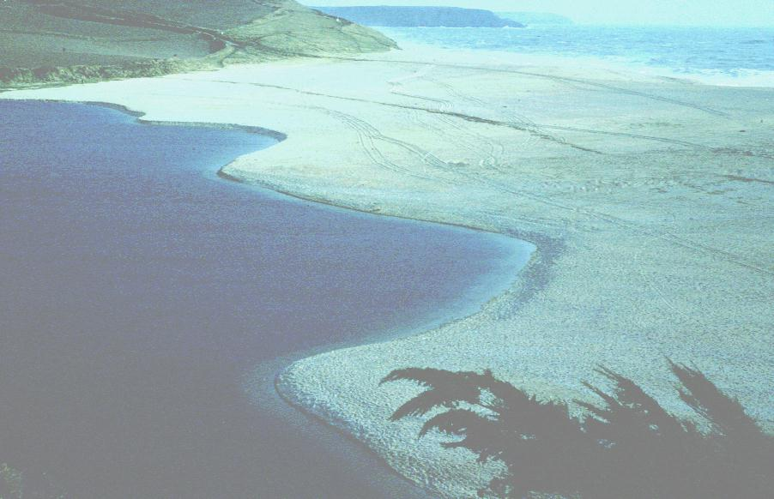
April 1979

Slide 16
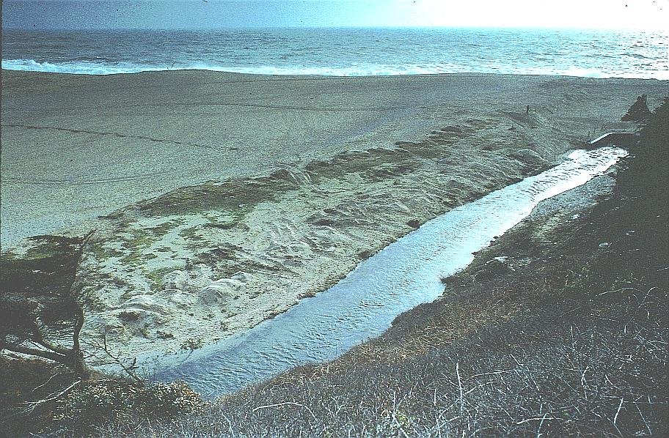
April 1979

Slide 17
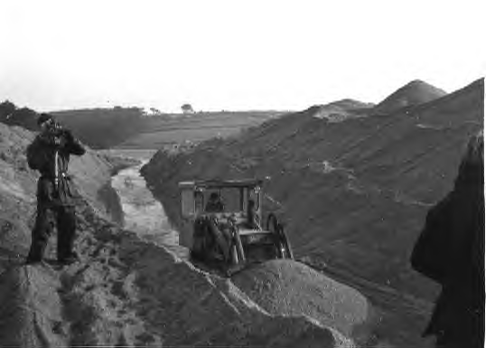
15th Feb 1979

Slide 18
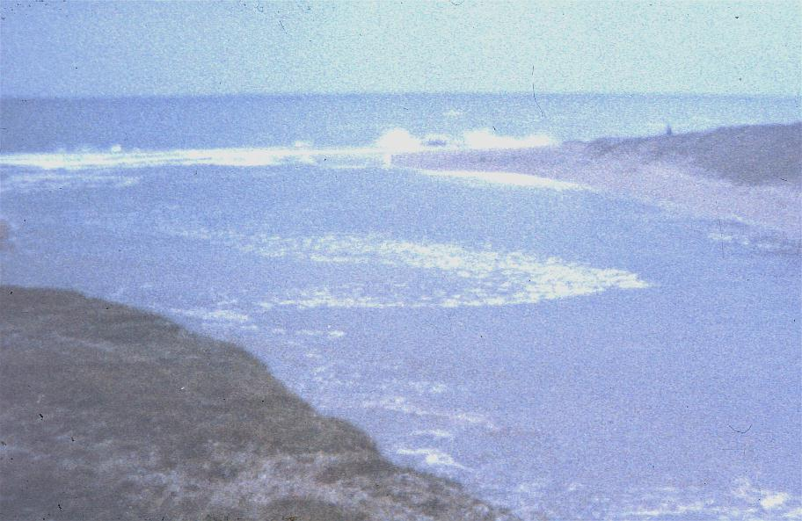
1979 breach

Slide 19
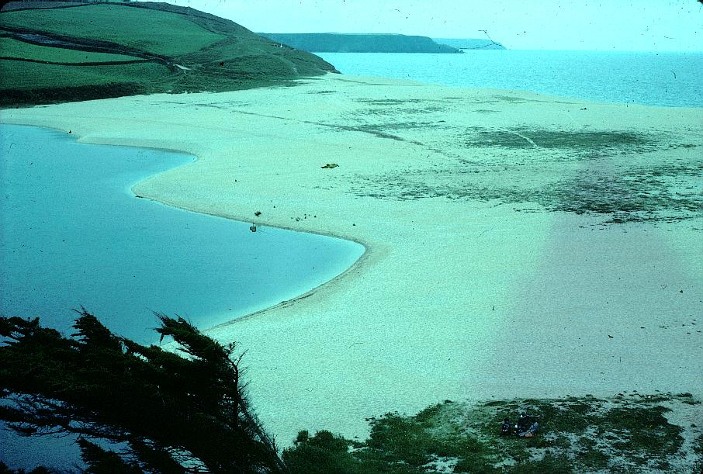
June 1979

Slide 20
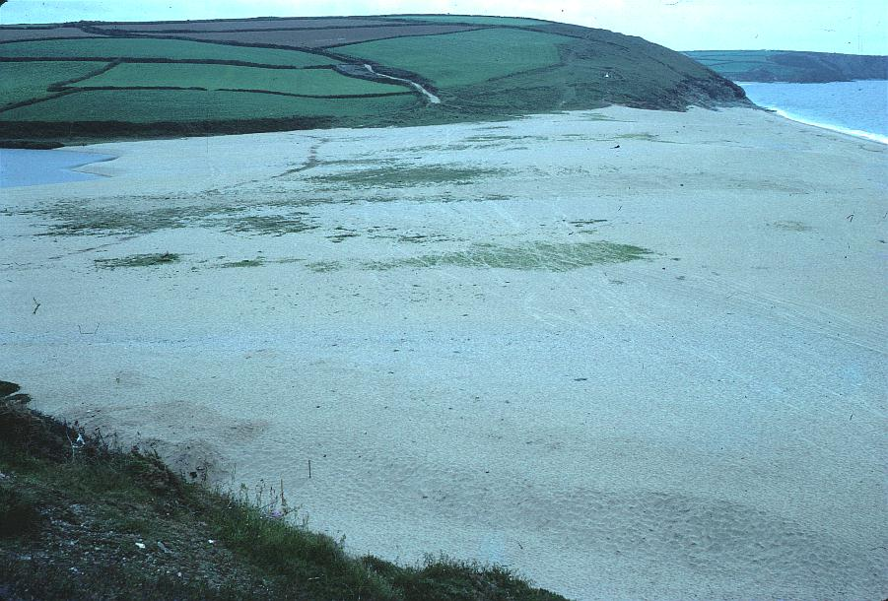
June 1979

Slide 21
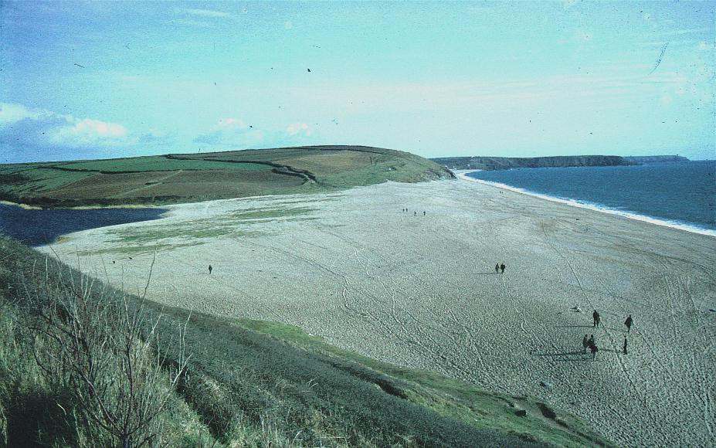
June 1979

Slide 22
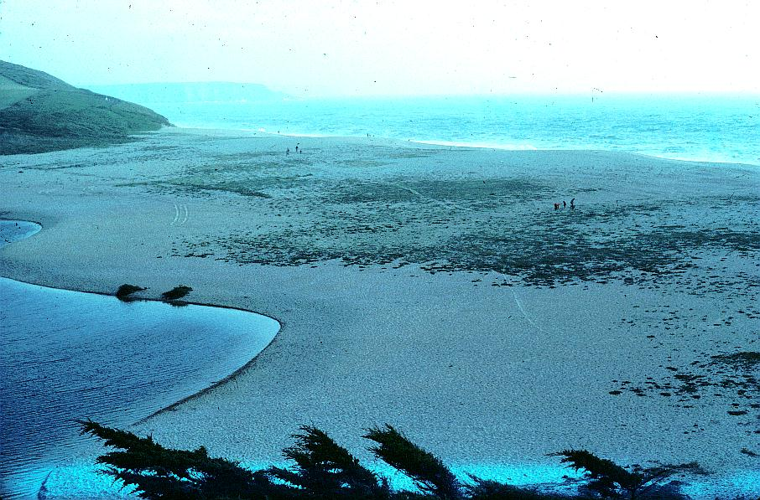
Oct 1979

Slide 23
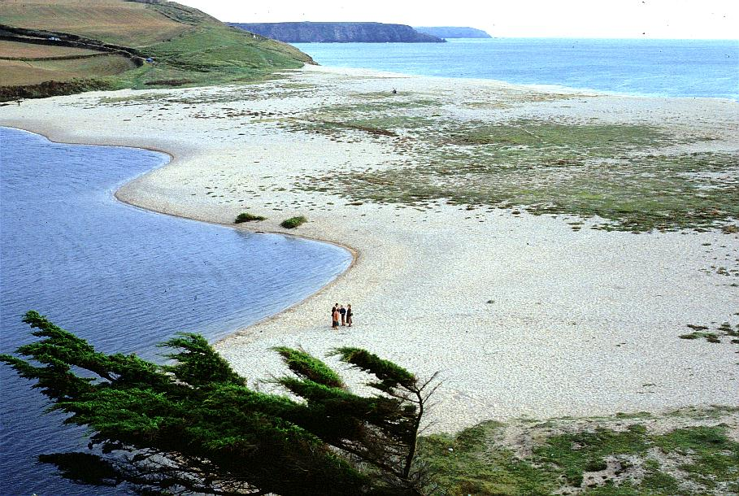
Sept 1980

Slide 24
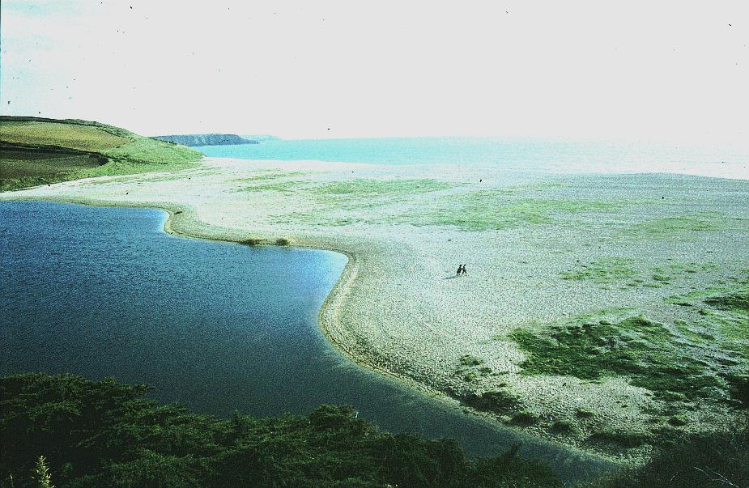
Feb 1983

Slide 25
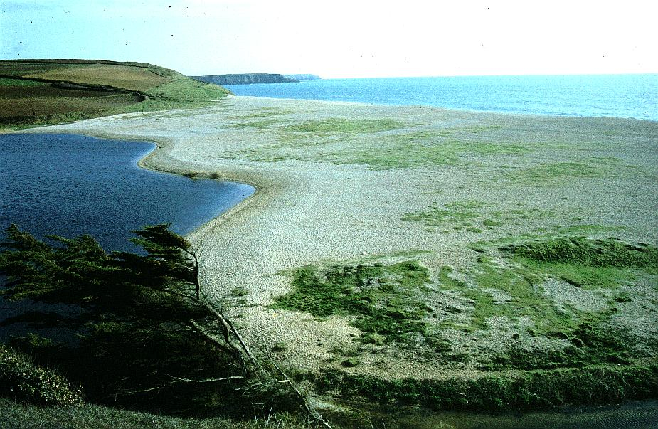
March 1983

Slide 26
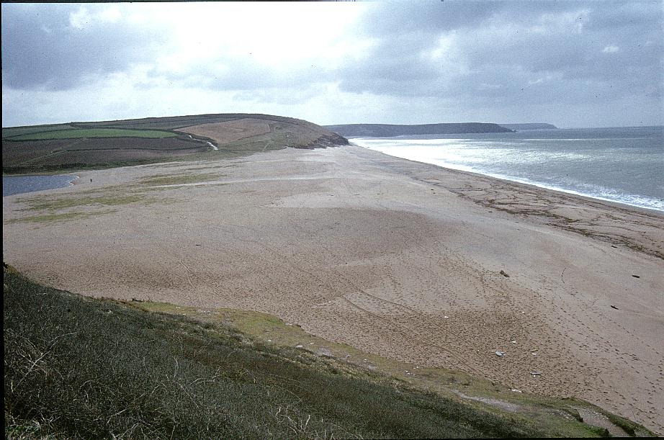
April 1983

Slide 27
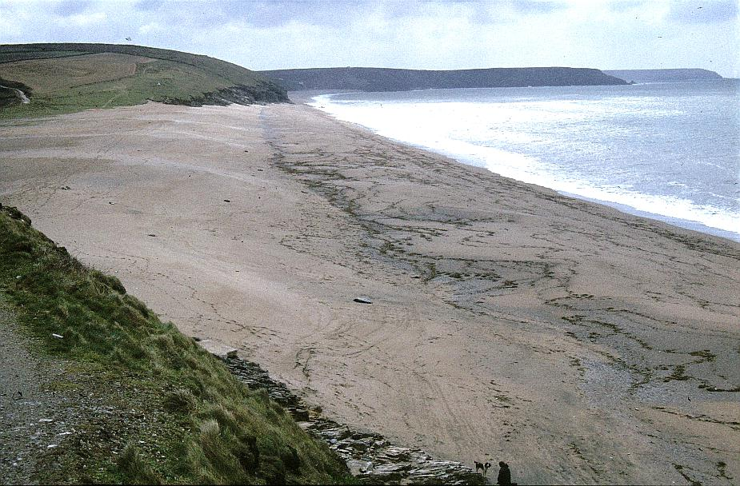
April 1983

Slide 28
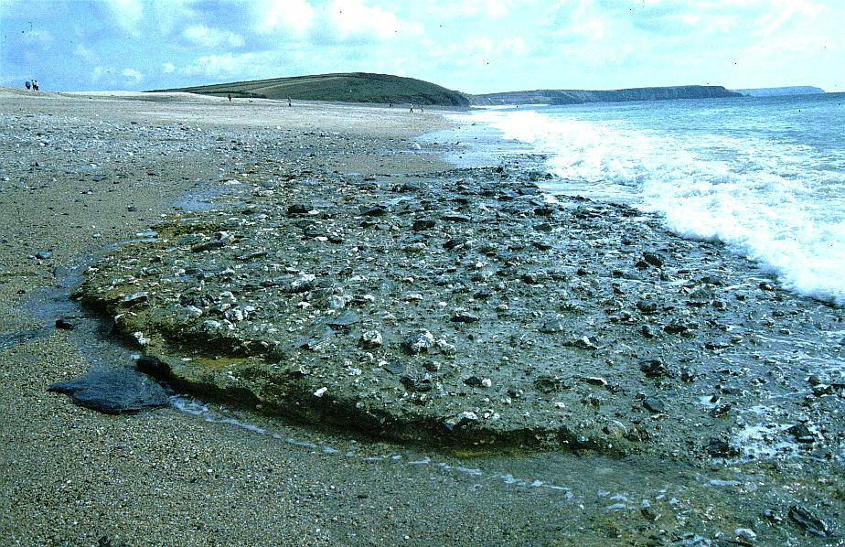
April 1983 exposed periglacial head under Bar

Slide 29
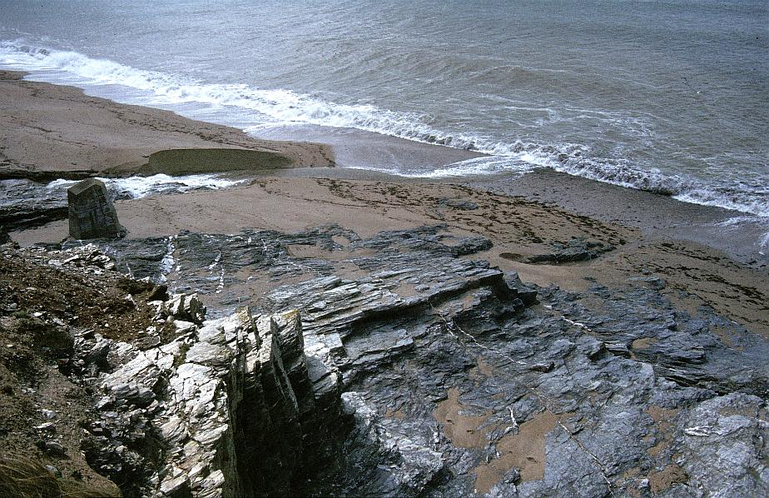
April 1983

Slide 30
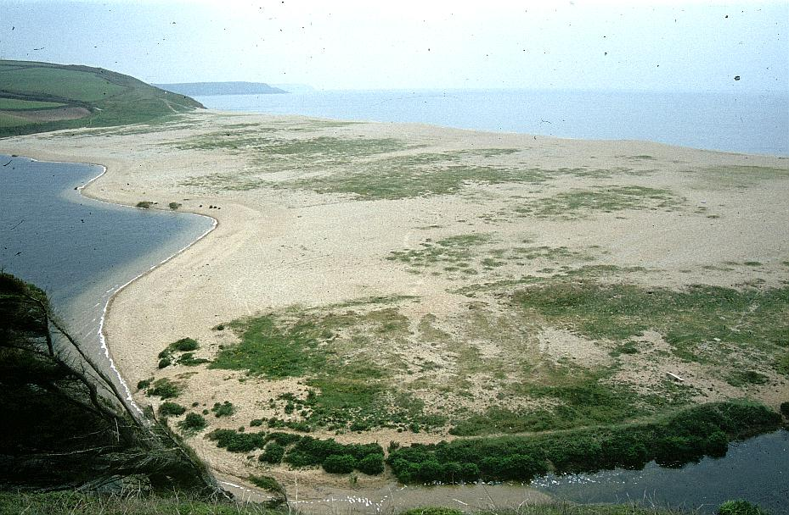
April 1984

Slide 31
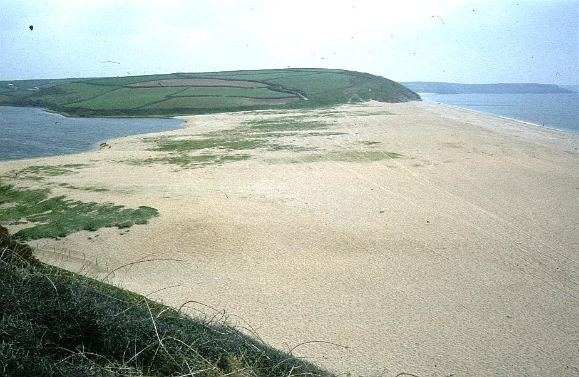
May 1984

Slide 32
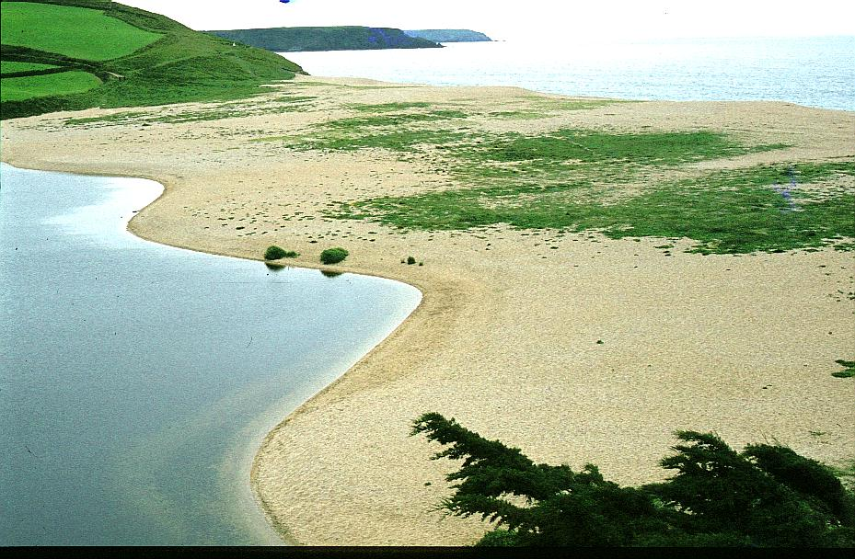
Aug 1984

Slide 33
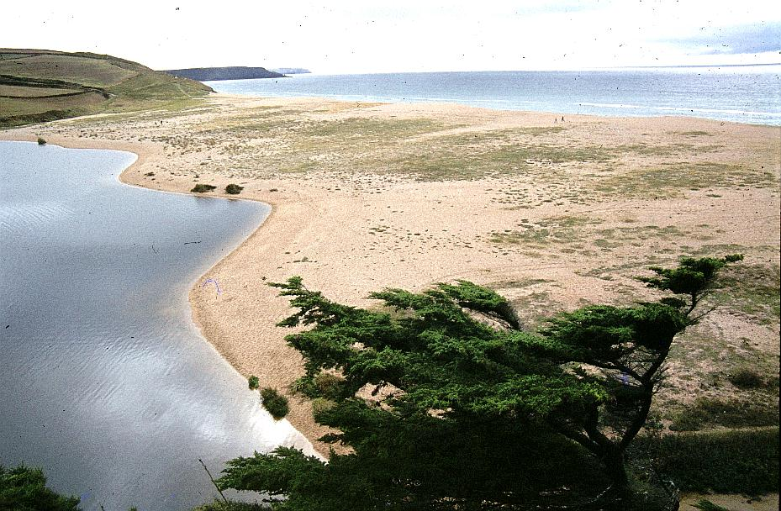
Sept 1984

Slide 34
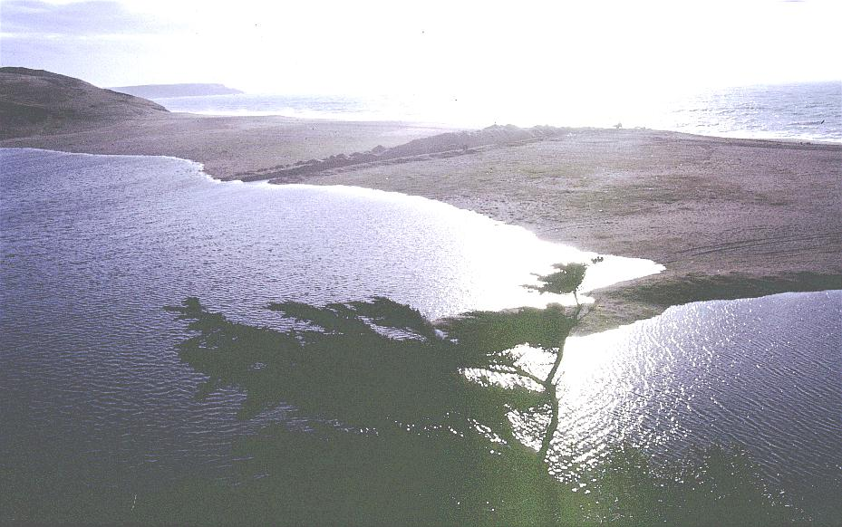
Nov 1984

Slide 35
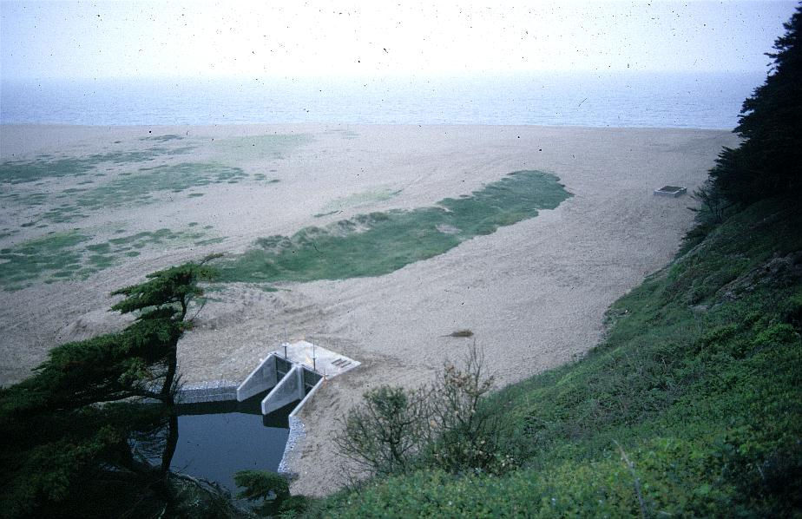
Sept 1984

Slide 36
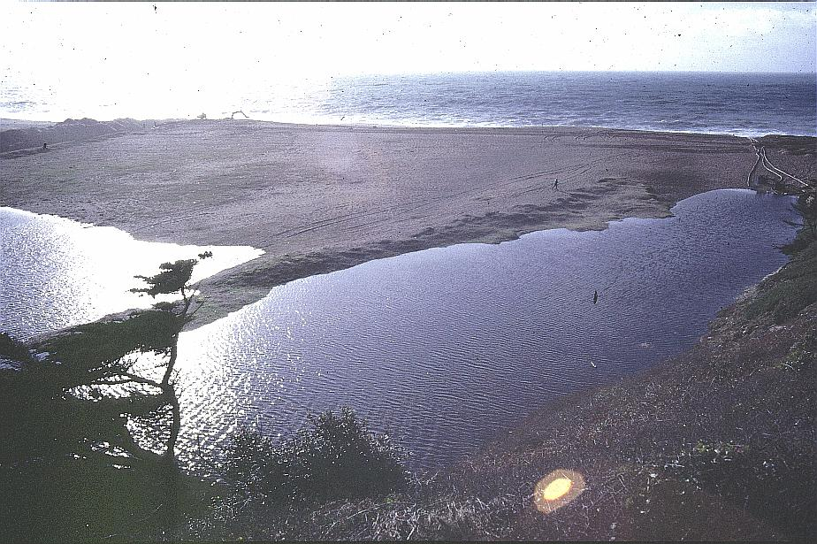
Nov 1984

Slide 37
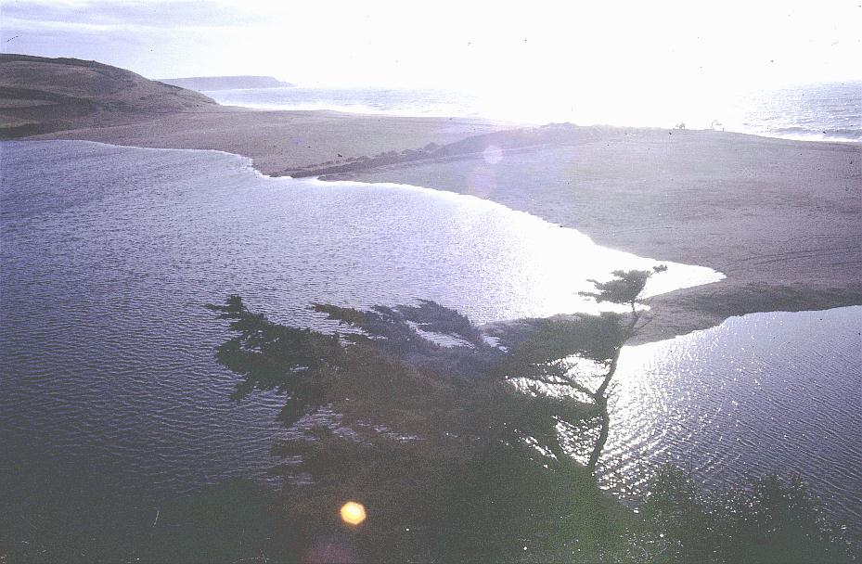

Slide 38
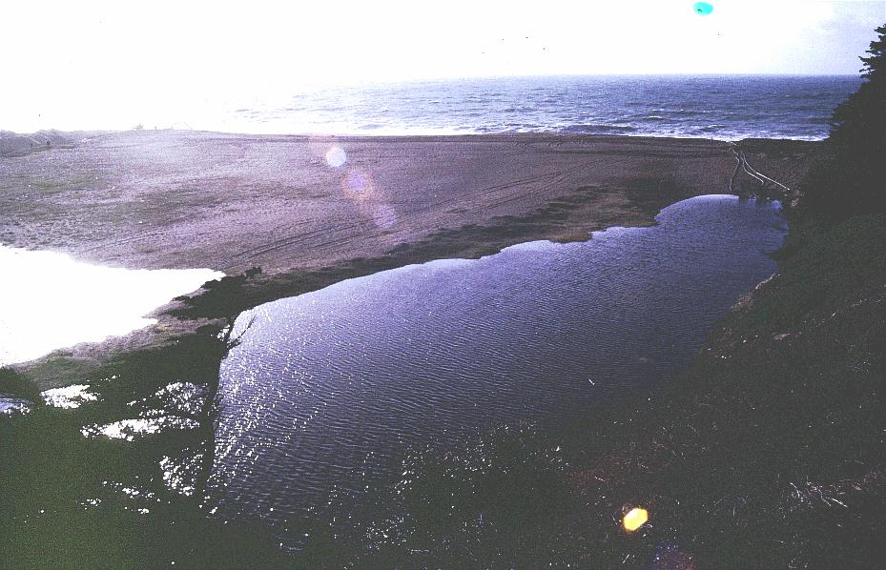
Nov 1984

Slide 39
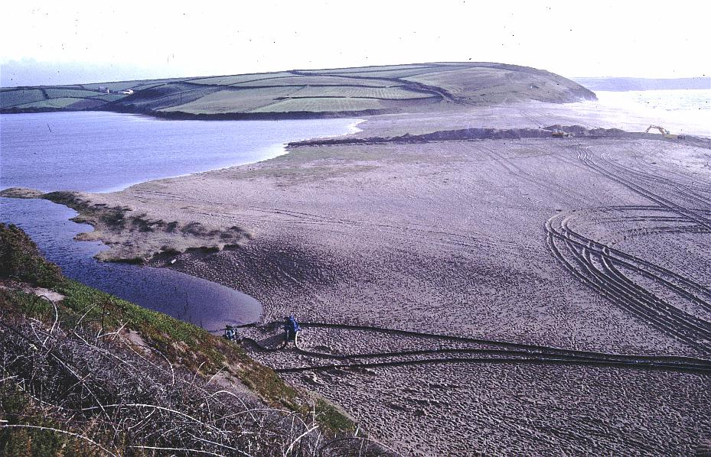
Nov 1984

Slide 40
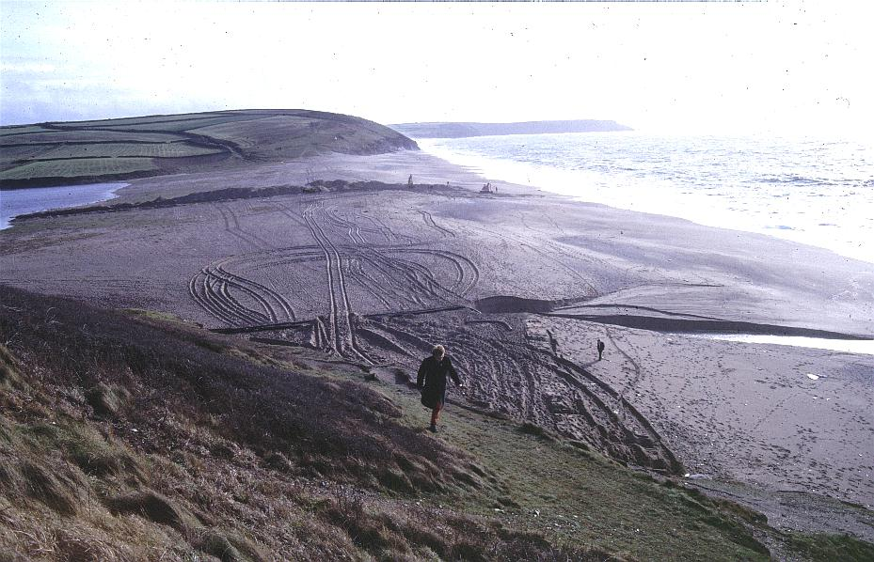
Nov 1984

Slide 41
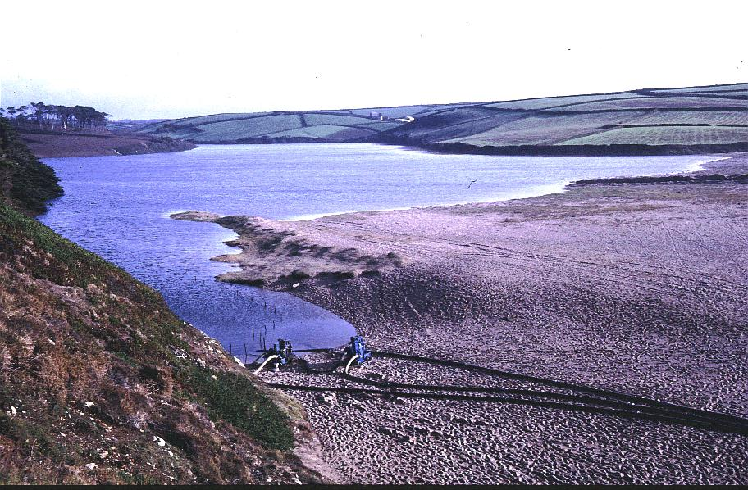

Slide 42
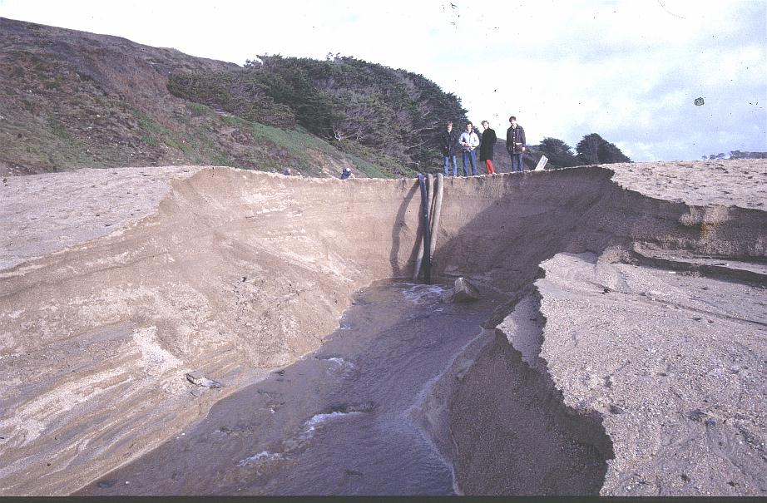

Slide 43
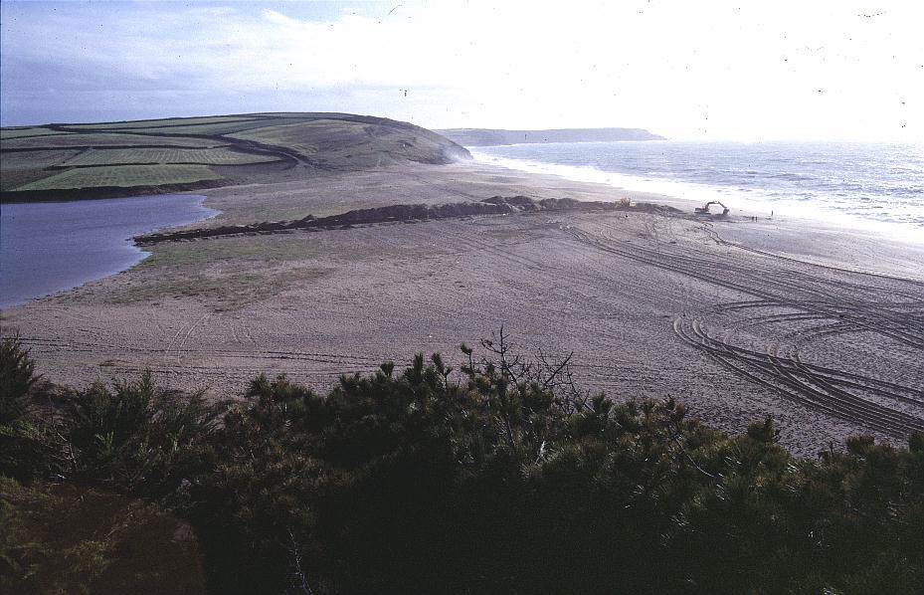
Nov 1984

Slide 44
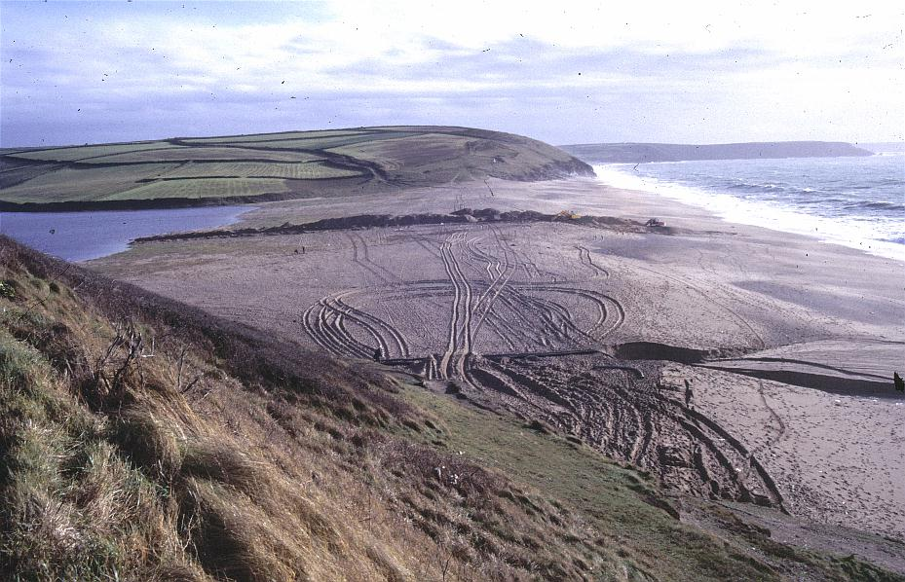
Nov 1984

Slide 45
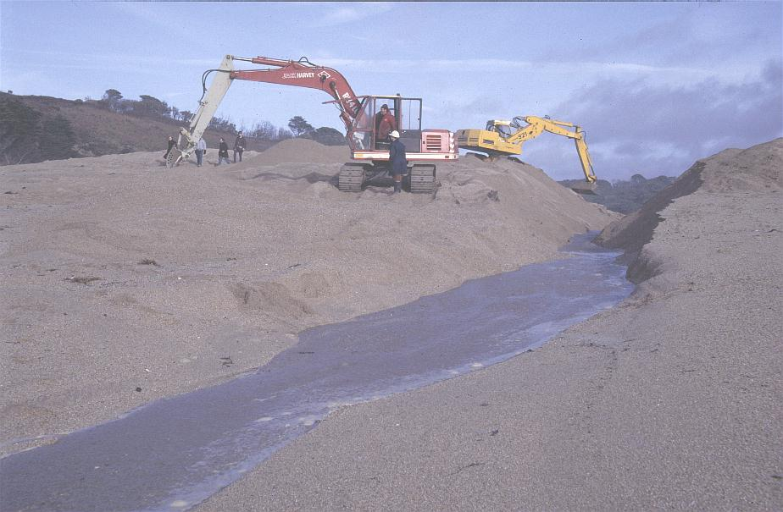
Nov 1984

Slide 46
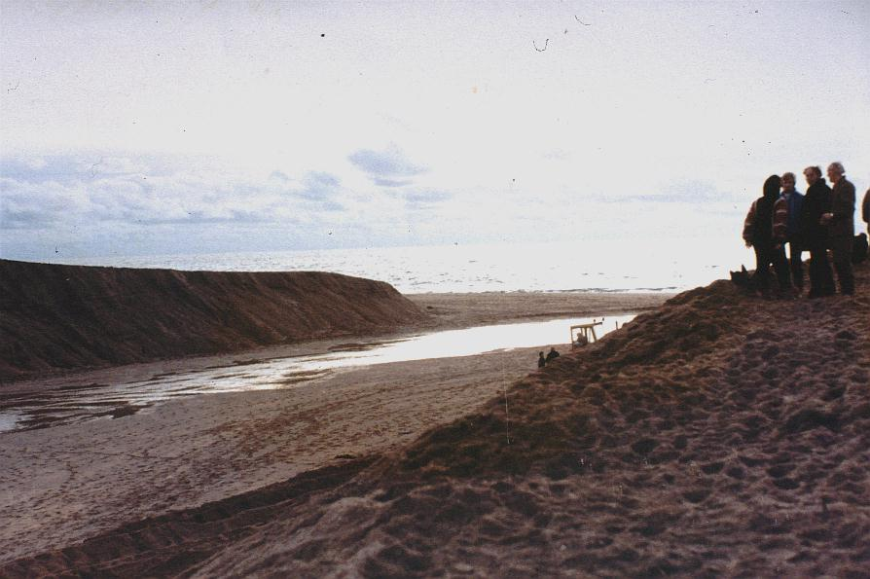
Nov 1984

Slide 47
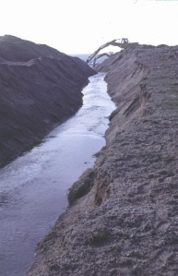

Slide 48
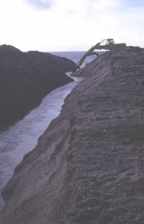

Slide 49
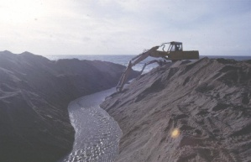

Slide 50
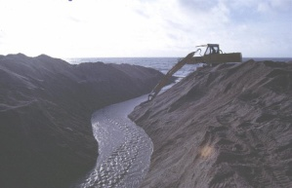

Slide 51
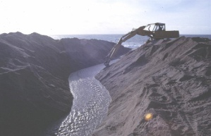

Slide 52

Feb 1985

Slide 53

June 1985

Slide 54

June 1985

Slide 55

July 1985

Slide 56

What was left of the Pool

Slide 57

April 1986

Slide 58

July 1986

Slide 59


Slide 60


Slide 61


Slide 62


Slide 63

June 1987

Slide 64
June 1987

Slide 65

Oct 1987

Slide 66

Dec 1987

Slide 67

May 1988

Slide 68

Algal bloom Aug 1988

Slide 69

Algal bloom July 1988

Slide 70

April 1989

Slide 71

June 1989

Slide 72

Dec 1989

Slide 73

Dec 1989

Slide 74

June 1990

Slide 75

Jan 1991

Slide 76

Algal bloom July 1992

Slide 77

March 1993

Slide 78

March 1993

Slide 79

June 1993

Slide 80

Algal bloom July 1993

Slide 81

Nov 1993

Slide 82

Nov 1993

Slide 83

Nov 1993

Slide 84

Nov 1993

Slide 85

March 1994

Slide 86

Algal bloom July 1994

Slide 87

Algal Bloom July 1994

Slide 88

Sewage fungus Lower Nansloe Stream July 1995

Slide 89

Algal bloom July 1995

Slide 90

July 1995

Slide 91

Jan 1997

Slide 92

Jan 1997

Slide 93

Jan 1997

Slide 94

Diesel pollution incident June 1997

Slide 95


Slide 96


Slide 97

Sept 1998

Slide 98

Sept 1998

Slide 99

Algal bloom Sept 1998

Slide 100

Algal bloom Sept 1998

Slide 101

Sept 1998

Slide 102

Oct 2001

Slide 103

Oct 2001

Slide 104

Oct 2001

Slide 105

Oct 2001

Slide 106

Oct 2001

Slide 107
Oct 2001

Slide 108

Oct 2001

Slide 109

Jan 2003

Slide 110

June 2003

Slide 111

June 2003

Slide 112

June 2003

Slide 113

Iron Pan in Bar

Slide 114


Slide 115

July 2004

Slide 116

July 2004

Slide 117

Nov 2005

Slide 118

Nov 2005

Slide 119

Feb 2006

Slide 120

Feb 2006

Slide 121

Nov 2007

Slide 122

Nov 2007

Slide 123

Dec 2009

Slide 124

Dec 2009

Slide 125

Dec 2009

